Slide 1
RESTAURANT FOOD ORDERING SYSTEM
ARANYA SINGH CHAUHAN : RA1911028010008
PRANIT TANDON : RA1911028010014

Slide 2
MODULE 2

Slide 3
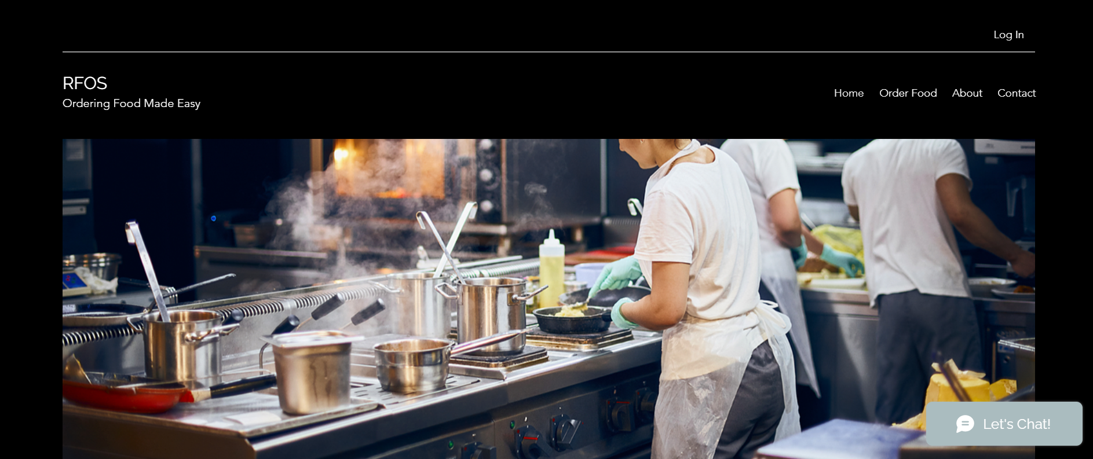
Home Page

Slide 4


Slide 5
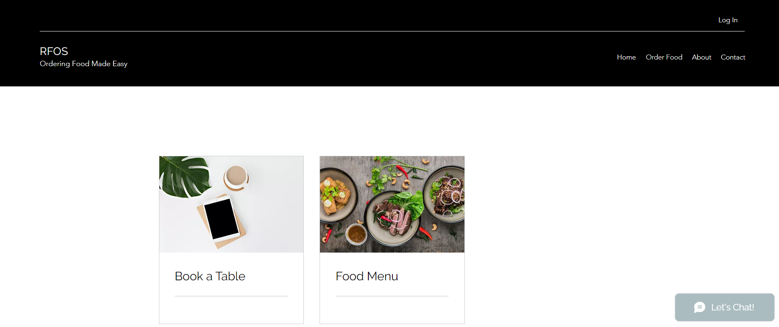
Order Food

Slide 6
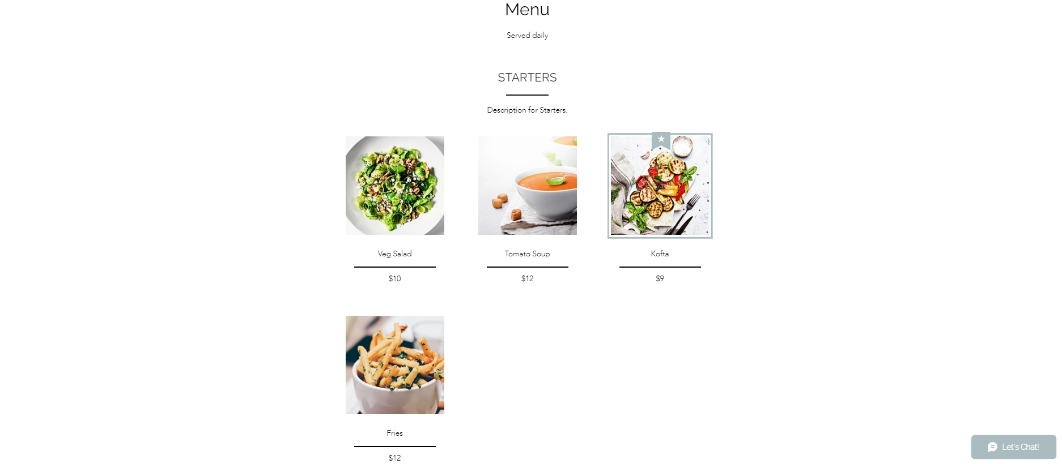
Food Menu

Slide 7
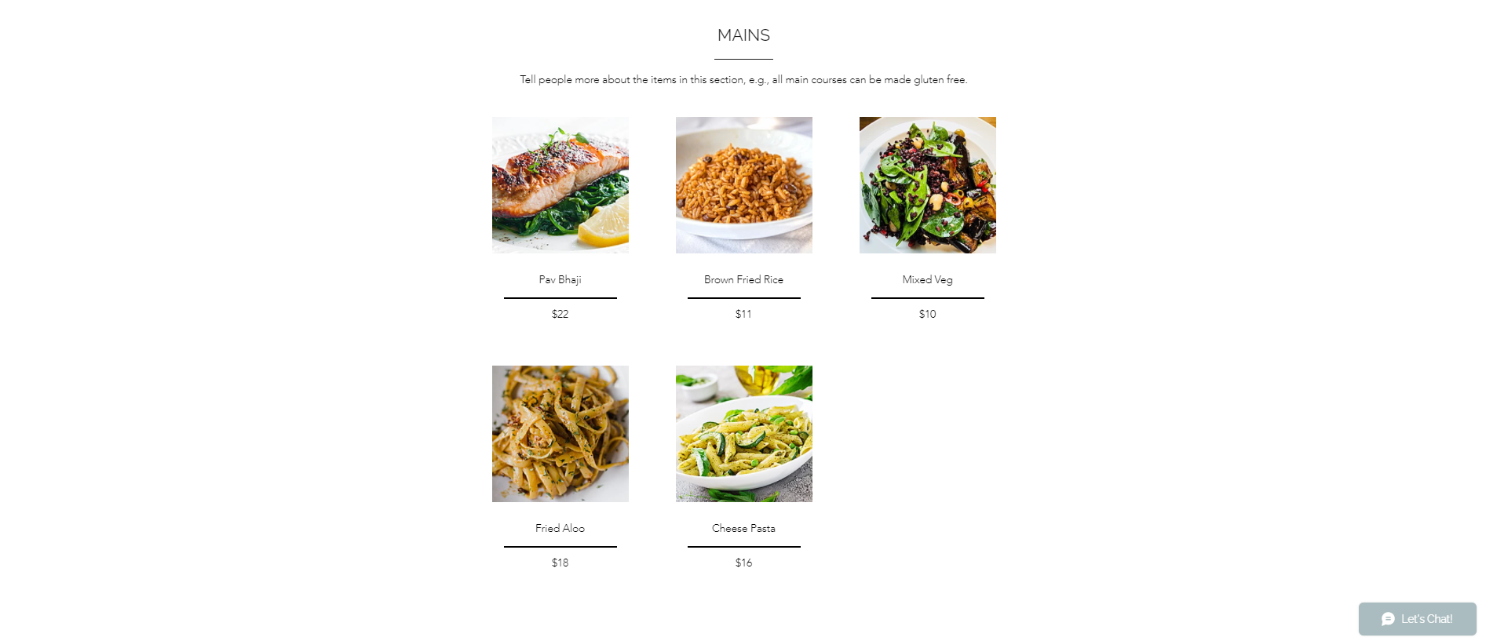

Slide 8
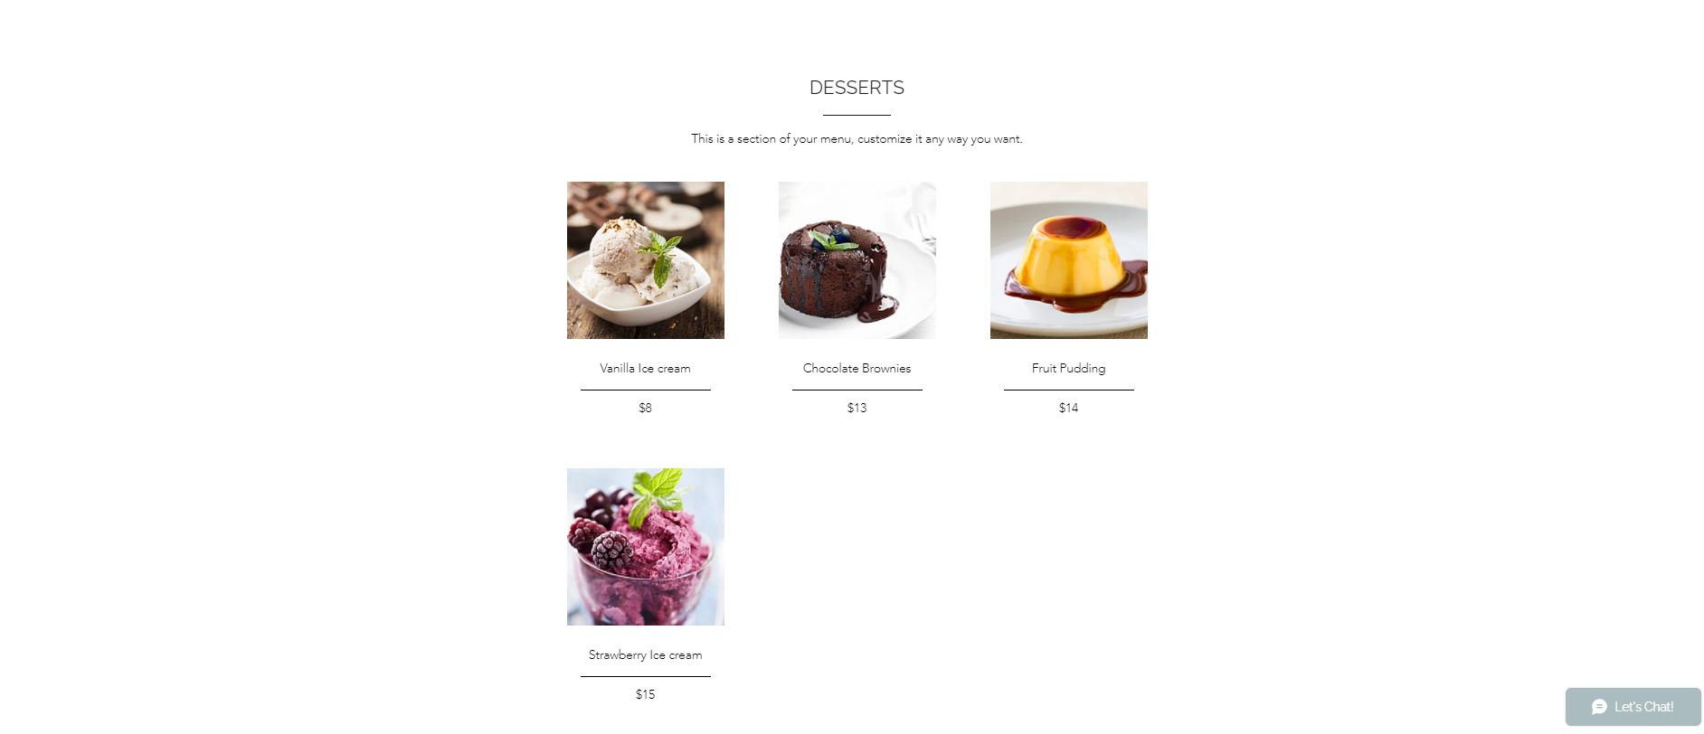

Slide 9
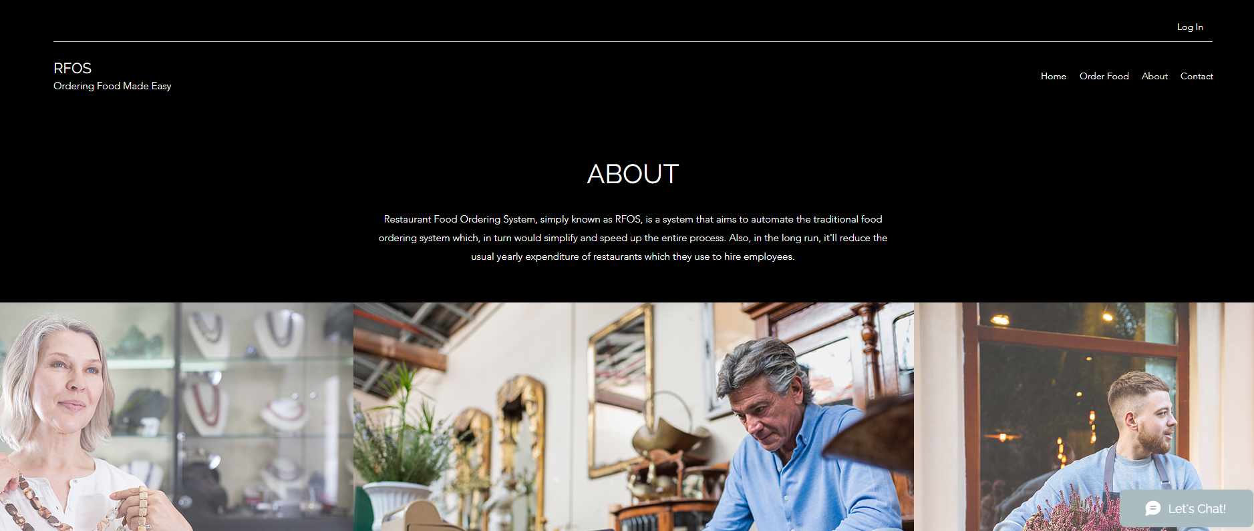
About

Slide 10
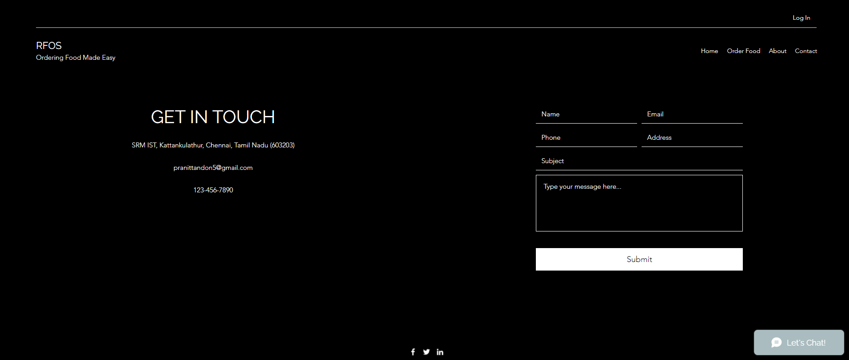
Contact

Slide 11
THANK YOU

